Slide 1
Generative Adversarial Networks (GANs)
A gentle Introduction
https://github.com/toelt-llc/GANs-TensorFlow
Umberto Michelucci
umberto.michelucci@toelt.ai
+41 79 396 7406

Slide 2
Problem Description
Discriminative (classifiers) models can
Given an image X, predict a label Y
Estimates P(Y|X)
Discriminative models have several key limitations
Can’t model P(X), i.e. the probability of seeing a certain image
Thus, can’t sample from P(X), i.e. can’t generate new images
Generative models (in general) cope with all of above
Can model P(X)
Can generate new images

Slide 3
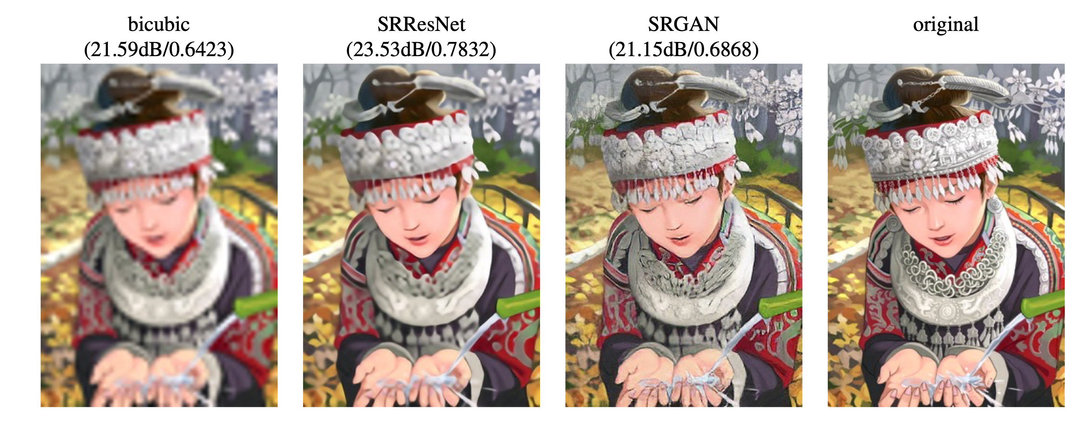
GANs for Superresolution
Ledig, Christian, et al. "Photo-realistic single image super-resolution using a generative adversarial network." arXiv preprint arXiv:1609.04802 (2016).

Slide 4
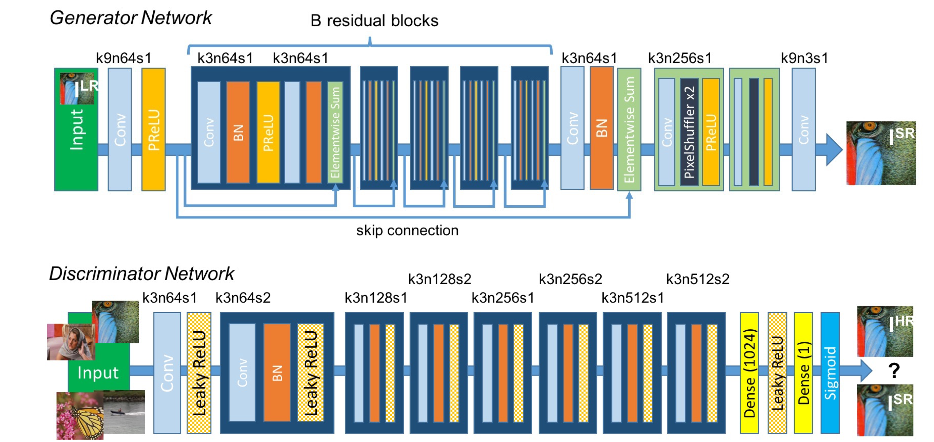
Example of Network Architecture
Ledig, Christian, et al. "Photo-realistic single image super-resolution using a generative adversarial network." arXiv preprint arXiv:1609.04802 (2016).

Slide 5


Painter: she would like to learn to learn to paint as Van Gogh
Critic: she would like to learn be able to tell real Van Gogh paintings from fakes apart.

Slide 6
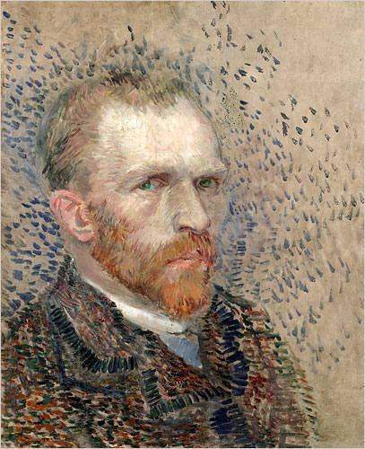
Step 1
The painter becomes slowly better
Then the critic tells the painter what was clearly wrong.
Critic: she would like to learn be able to tell real Van Gogh paintings from fakes apart.
Produce a fake portrait that is not perfect
Painter: she would like to learn to learn to paint as Van Gogh
The critic try to determine if the painting is fake or not.
FAKE

Slide 7
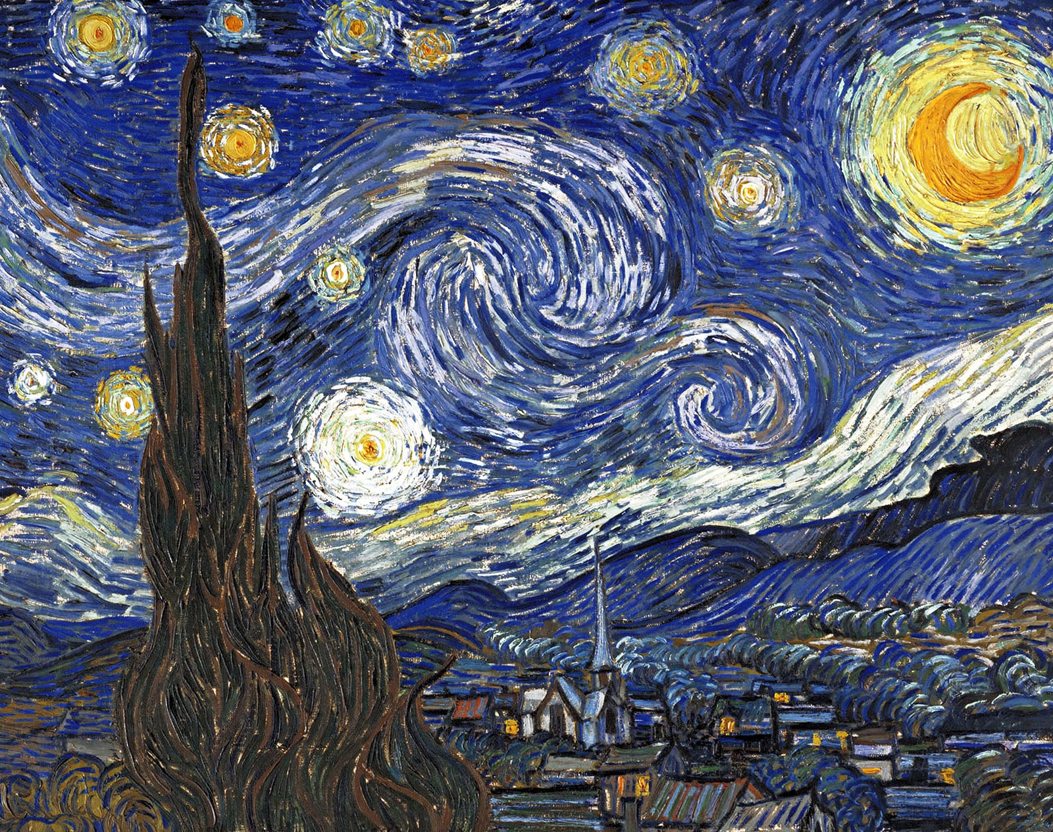
Step 2 – The critic must become better too
The critic trains with real Van Gogh paintings
The critic becomes slowly better
Critic: she would like to learn be able to tell real Van Gogh paintings from fakes apart.
TRUE
The critic trains with clearly fake Van Gogh paintings
FAKE

Slide 8
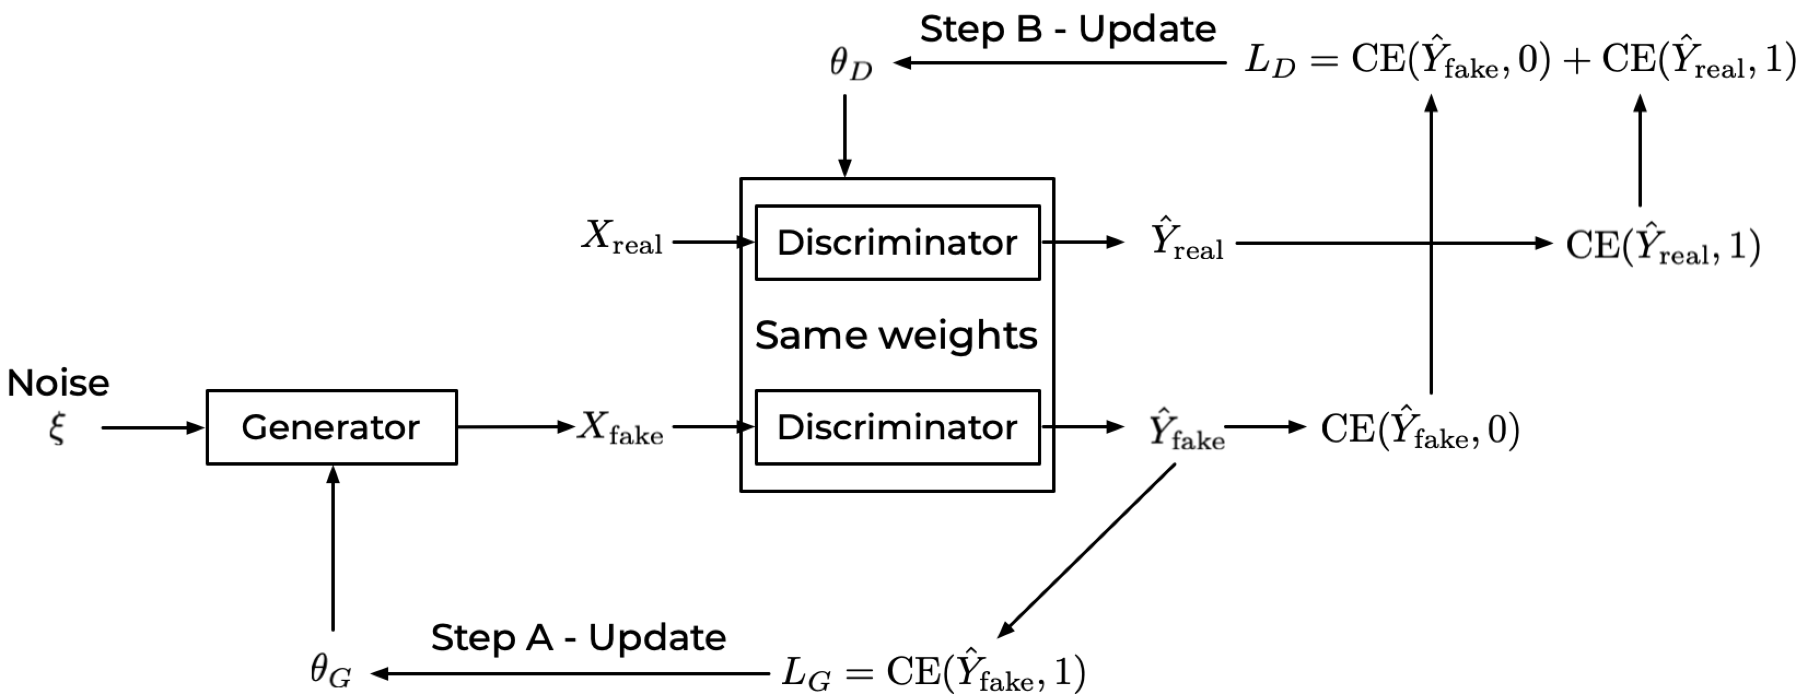
Step 2
Ideas of the painter (today I will paint a portrait,
a landscape, etc.)
Step 1

Slide 10
Reference – Loss Function (Cross Entropy, CE)
Predicted Class probability of painting of being real (class 1)
Class Label: 0,1
0 → Painting is fake
1 → Painting is real

Slide 11
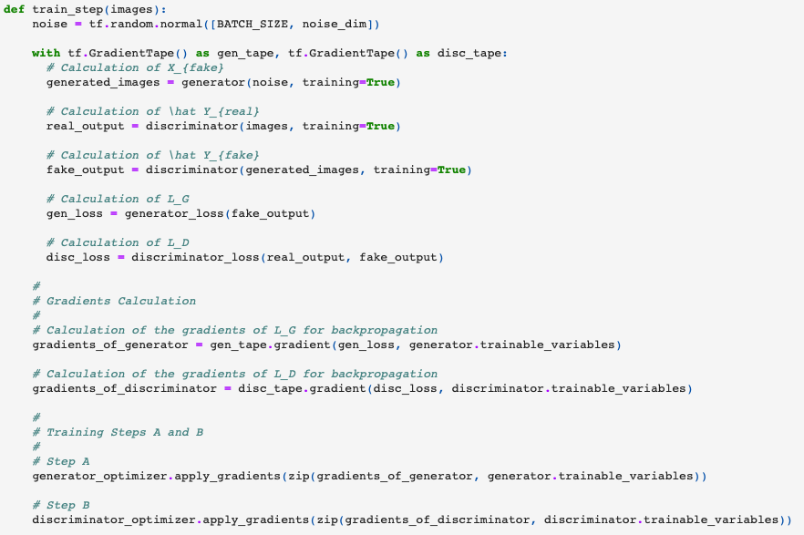
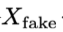
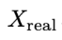
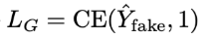
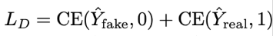
How to use Keras for GANs
The most important aspect of using Keras for GANs is the necessity of building a custom training loop (and not using compile()/fit() approach.

Slide 12
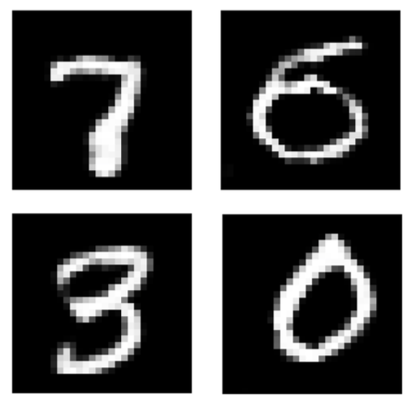
The digits were not written by a person…

Slide 13
Conditional GAN
Conditional GAN (CGAN) is a GAN variant in which both the Generator and the Discriminator are conditioned on auxiliary data such as a class label during training.
Source: https://livebook.manning.com/book/gans-in-action/chapter-8/

Slide 14
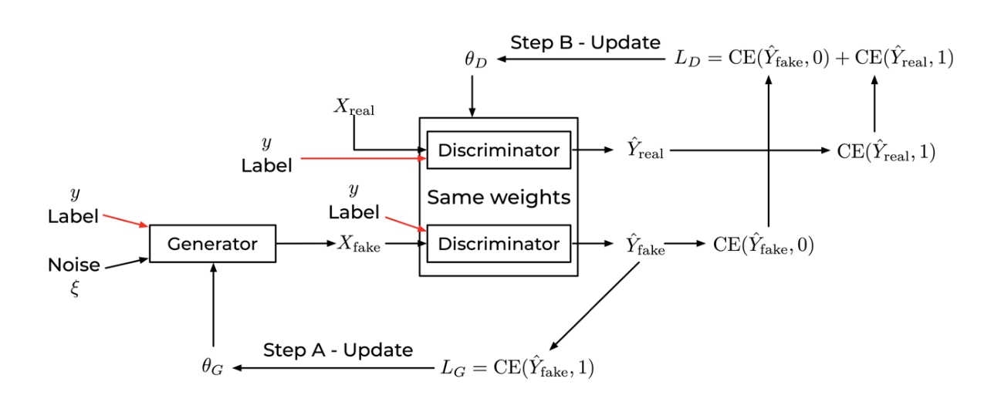
Conditional GAN

Slide 15
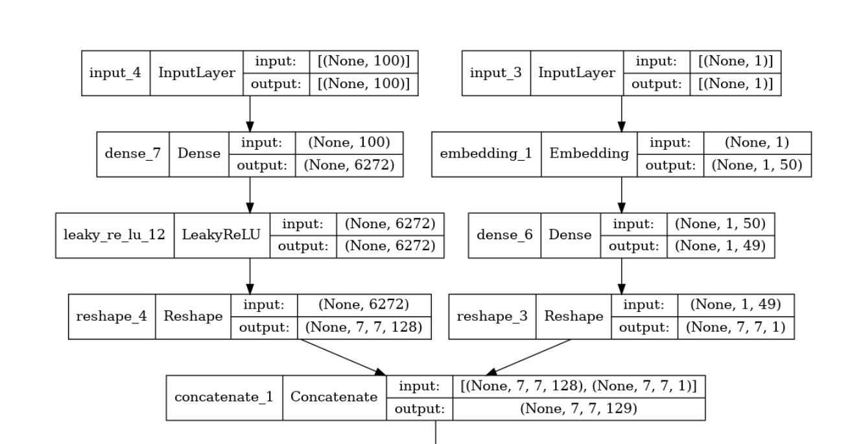
First Layers of the generator (CGAN)

Slide 16
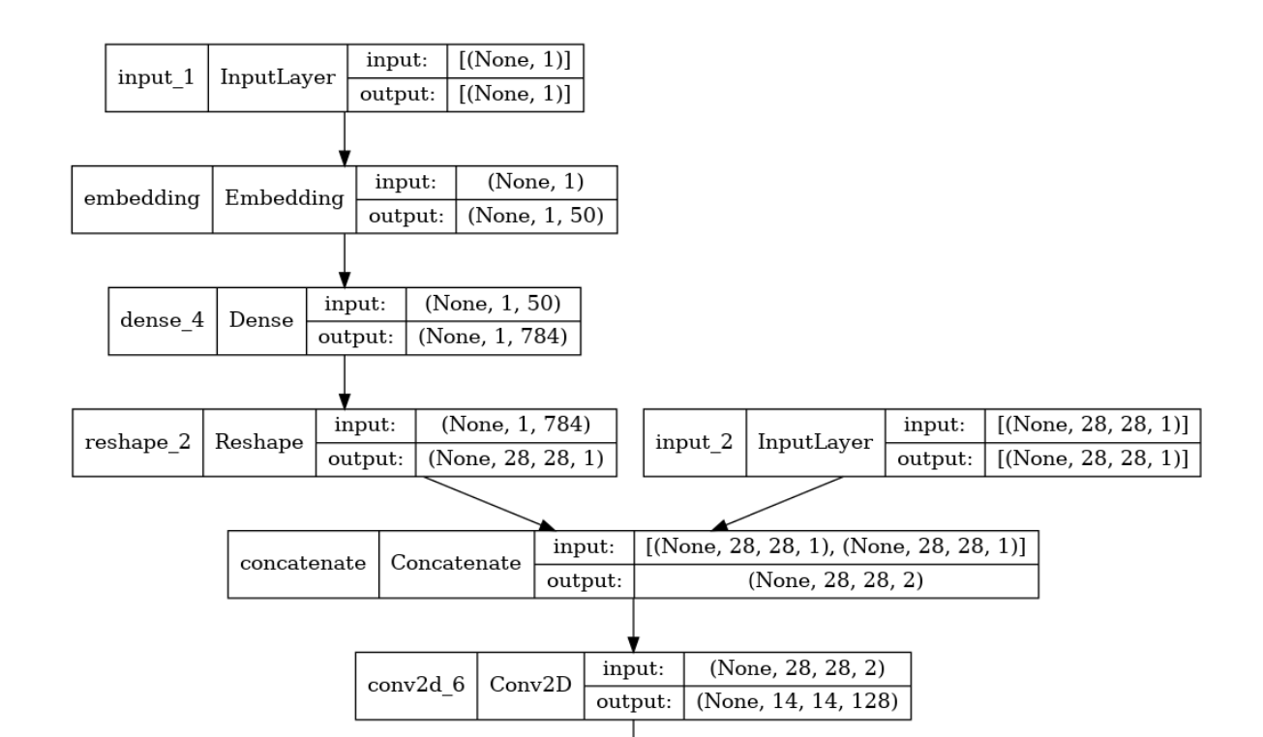
First Layers of the discriminator (CGAN)

Slide 17
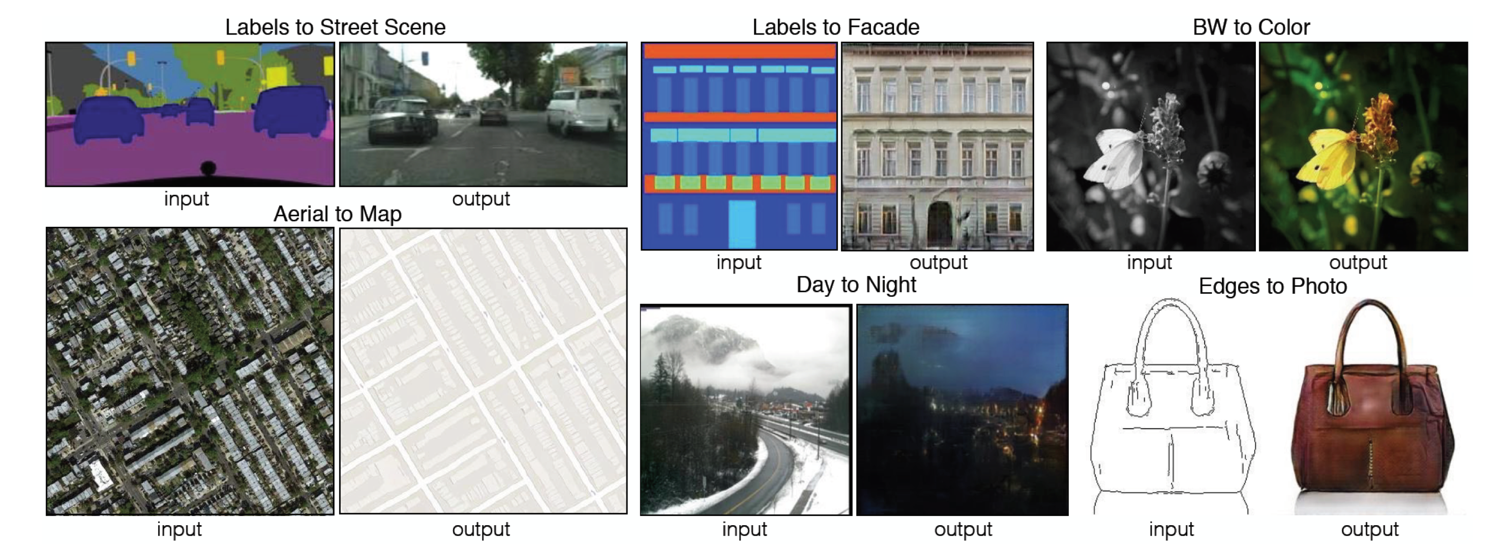
Image-to-image Translation
Isola, Phillip, et al. "Image-to-image translation with conditional adversarial networks." Proceedings of the IEEE conference on computer vision and pattern recognition. 2017.

Slide 18
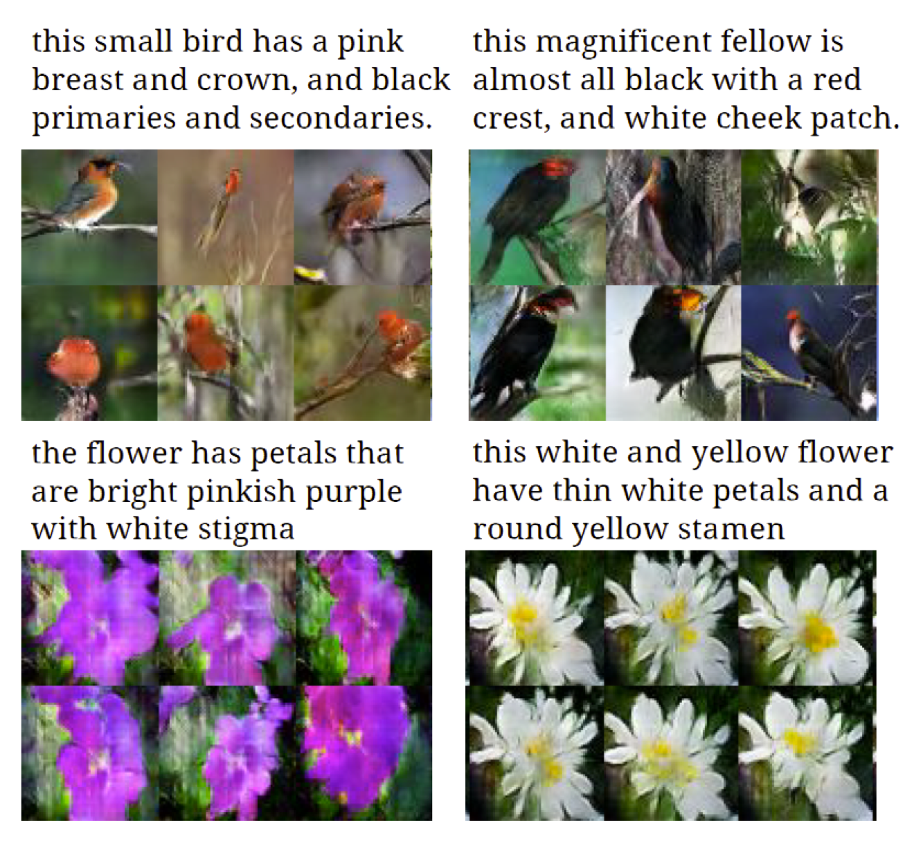
Text-to-image Synthesis
Given a text, generate images closely associated.
One uses a conditional GAN with the generator and discriminator working with text embeddings.
Reed, Scott, et al. "Generative adversarial text to image synthesis." International conference on machine learning. PMLR, 2016.

Slide 19
Reading List I/II
Goodfellow, I., Pouget-Abadie, J., Mirza, M., Xu, B., Warde-Farley, D., Ozair, S., Courville, A. and Bengio, Y. Generative adversarial nets, NIPS (2014).
Goodfellow, Ian NIPS 2016 Tutorial: Generative Adversarial Networks, NIPS (2016).
Radford, A., Metz, L. and Chintala, S., Unsupervised representation learning with deep convolutional generative adversarial networks. arXiv preprint
arXiv:1511.06434. (2015).
Salimans, T., Goodfellow, I., Zaremba, W., Cheung, V., Radford, A., & Chen, X. Improved techniques for training gans. NIPS (2016).
Chen, X., Duan, Y., Houthooft, R., Schulman, J., Sutskever, I., & Abbeel, P. InfoGAN: Interpretable Representation Learning by Information Maximization
Generative Adversarial Nets, NIPS (2016).
Zhao, Junbo, Michael Mathieu, and Yann LeCun. Energy-based generative adversarial network. arXiv preprint arXiv:1609.03126 (2016).

Slide 20
Reading List II/II
Mirza, Mehdi, and Simon Osindero. Conditional generative adversarial nets. arXiv preprint arXiv:1411.1784 (2014).
Liu, Ming-Yu, and Oncel Tuzel. Coupled generative adversarial networks. NIPS (2016).
Denton, E.L., Chintala, S. and Fergus, R., 2015. Deep Generative Image Models using a Laplacian Pyramid of Adversarial Networks. NIPS (2015)
Dumoulin, V., Belghazi, I., Poole, B., Lamb, A., Arjovsky, M., Mastropietro, O., & Courville, A. Adversarially learned inference. arXiv preprint
arXiv:1606.00704 (2016).
Applications:
Isola, P., Zhu, J. Y., Zhou, T., & Efros, A. A. Image-to-image translation with conditional adversarial networks. arXiv preprint arXiv:1611.07004. (2016).
Reed, S., Akata, Z., Yan, X., Logeswaran, L., Schiele, B., & Lee, H. Generative adversarial text to image synthesis. JMLR (2016).
Antipov, G., Baccouche, M., & Dugelay, J. L. (2017). Face Aging With Conditional Generative Adversarial Networks. arXiv preprint arXiv:1702.01983.

